Slide 1
Wine Quality Analysis
Unsupervised Machine Learning
Milan Patel

Slide 2
Objective
To analyze the chemical properties of red and white wines separately using Principal Component Analysis (PCA) and K Means clustering. The goal is to perform dimensionality reduction through PCA to identify the principal components that capture the most variance in the data, and then apply K Means clustering to segment the wines into distinct clusters based on their chemical properties.
This analysis aims to uncover underlying patterns and groupings in the wines, which could provide insights into the factors influencing wine quality and assist in better understanding the relationship between chemical attributes and perceived quality.

Slide 3
Base plan
Read the red and white wine csv and create dataframes from them.
Cleaning the data: removing rows with values of zero or null in any cell and then using standard scaler to normalize the values.
EDA: Analyzing box plots of each column vs quality, observing quality distribution histograms and correlation matrices for both red and white wine dataset.
Applying PCA to do dimensionality reduction on both the datasets, analyzing the PCAs and then finding out the most important features.
Applying K-means clustering algorithm and then analyzing and trying to understand what each cluster represent using parallel coordinates plot.

Slide 4
Wine Dataset
All wines are produced in a specific region of Portugal. The dataset includes 12 different wine attributes, one of which is Quality, determined through sensory evaluation, while the others pertain to the wines' chemical properties, such as density, acidity, and alcohol content. The chemical properties are continuous variables, and Quality is an ordinal variable, ranging from 1 (worst) to 10 (best).

Slide 5
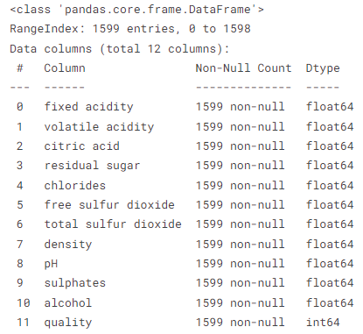
Wine Dataset Columns

Slide 6
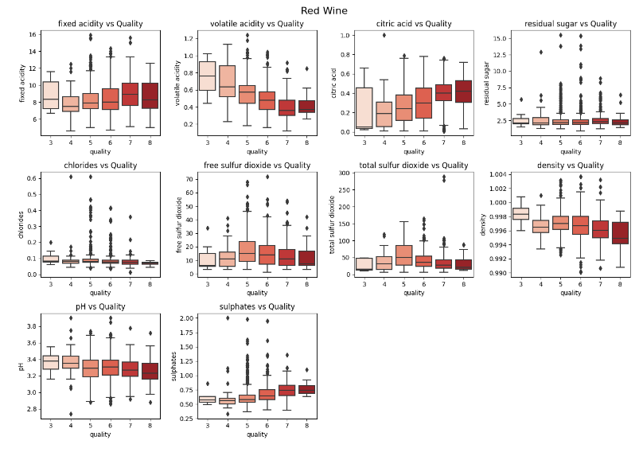

Slide 7
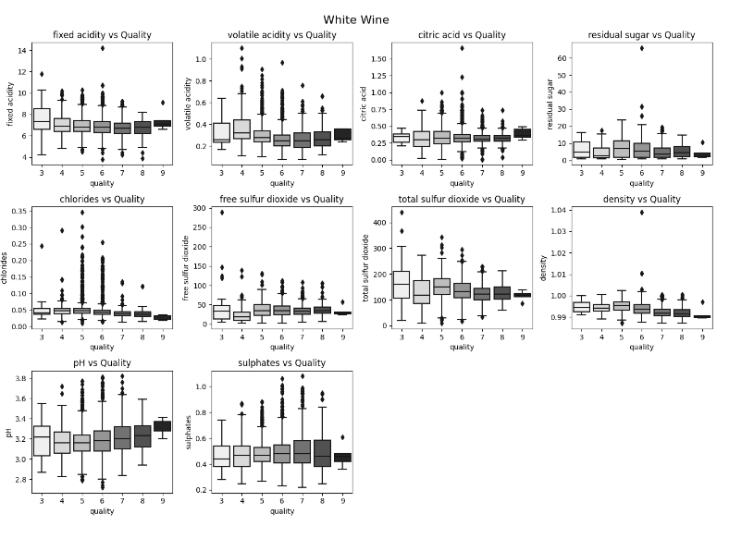

Slide 8
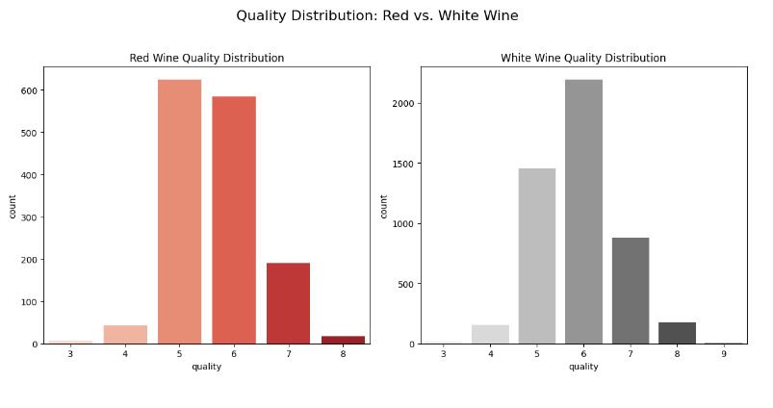

Slide 9
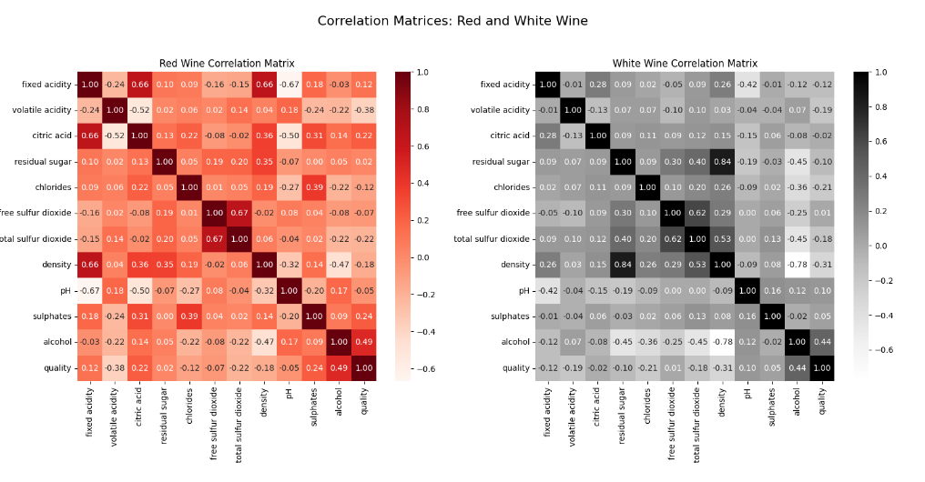

Slide 10
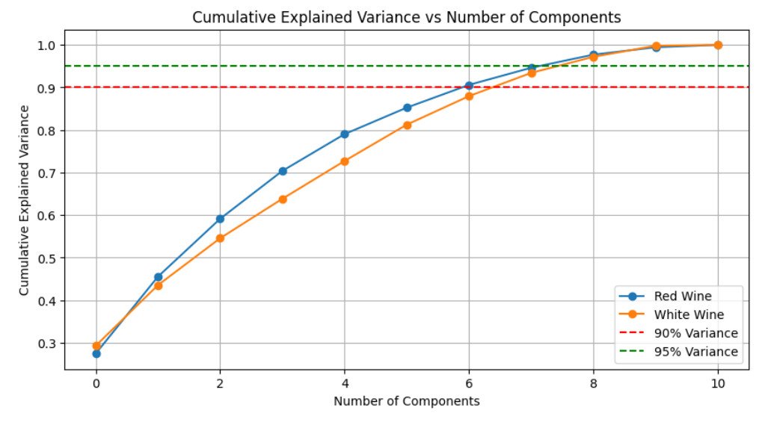

Slide 11
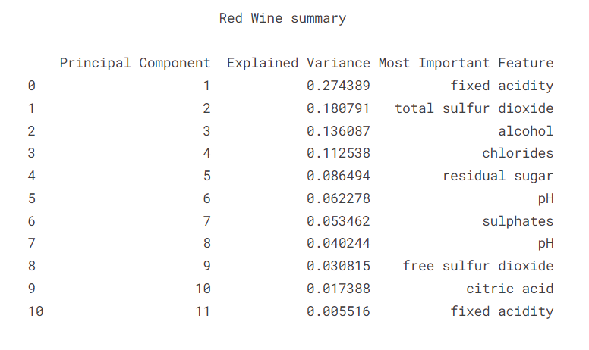

Slide 12
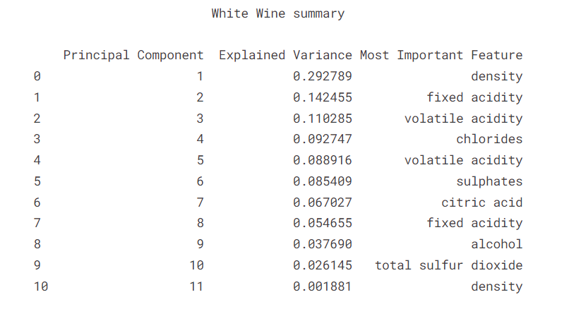

Slide 13
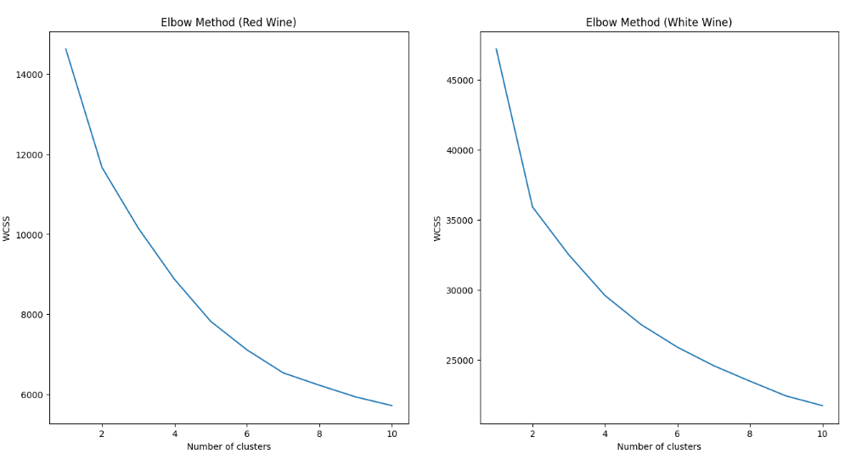

Slide 14
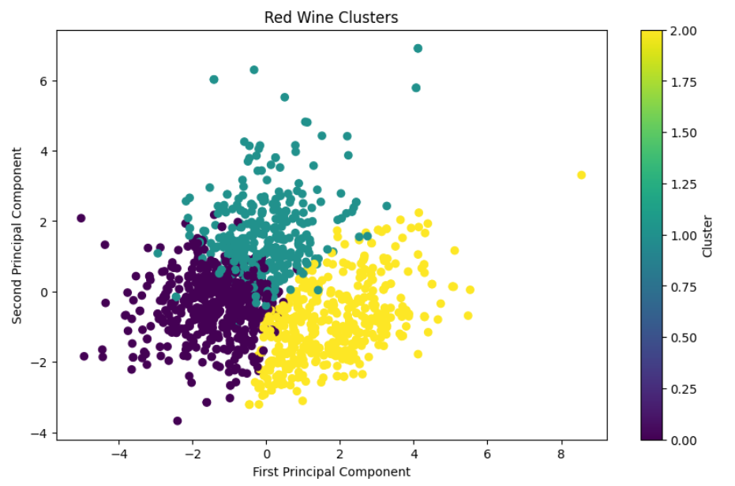

Slide 15
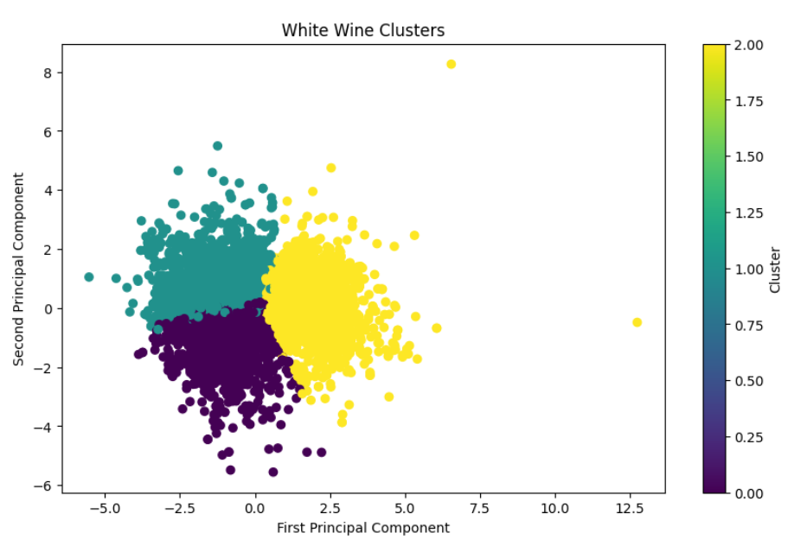

Slide 16
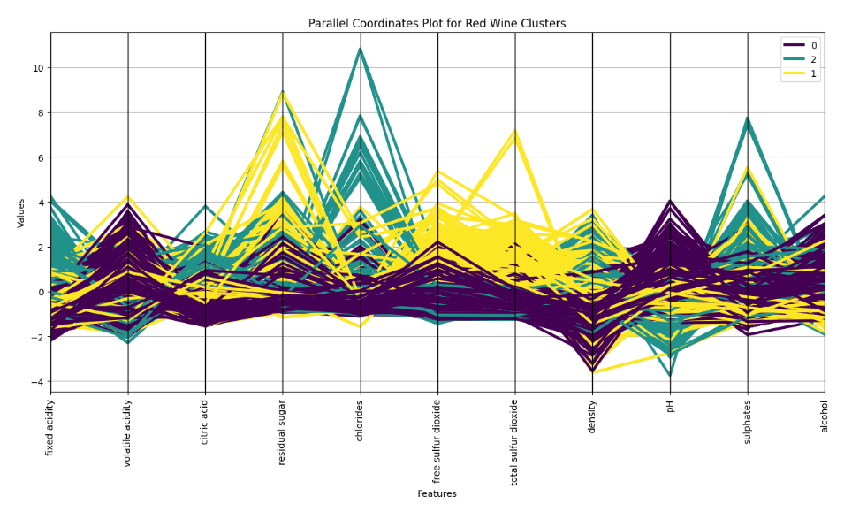

Slide 17
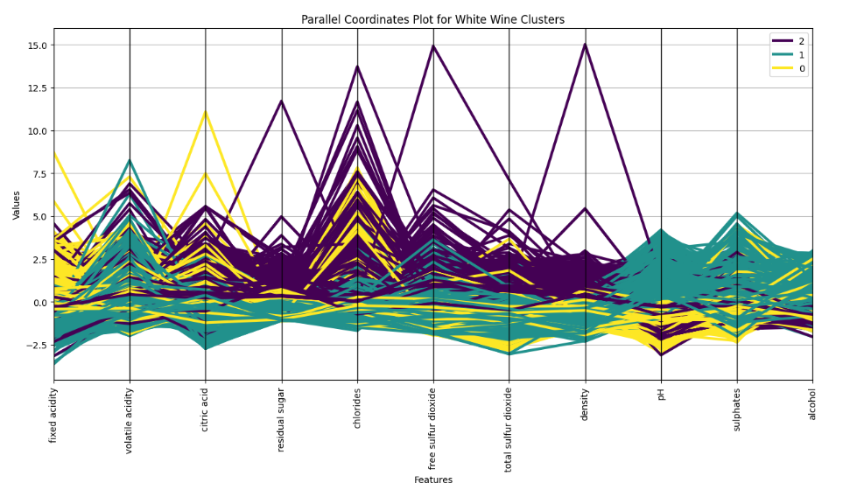

Slide 18
Summary
The project began with the goal of analyzing wine quality using a dataset that included various chemical properties of red and white wines. The initial step involved applying PCA to reduce the dimensionality of the data, allowing for more efficient and interpretable analysis.
Following PCA, clustering techniques such as K Means were applied to identify patterns within the wine data, leading to the creation of distinct clusters for both red and white wines. Visualizations, including parallel coordinates plots, were used to highlight the characteristics of these clusters, revealing differences in features like citric acid, residual sugar, and alcohol content among the clusters.

Slide 19
Future Improvements
Overall, the project demonstrated that PCA effectively reduced dimensionality while retaining key information, and clustering provided insights into the underlying structure of the data. Future improvements could include exploring other clustering methods, fine-tuning PCA components for optimal variance retention, and incorporating additional features or maybe doing anomaly detection.

